Slide 1
Case Study on : Waste water management

Slide 2
Table of Contents
Objectives | No of Slides
INTRODUCTION | 3
ACTUAL CASE STUDY : * Background * Challenges * Solution * Results * Lessons Learned | 4 - 6
BIBLOGRAPHY | 7

Slide 3

Introduction
Biogas power generation from sewage treatment plants in Chennai, India, represents a significant step towards sustainable energy production and environmental management. Chennai, the capital city of Tamil Nadu, faces challenges related to sewage management due to its burgeoning population and urbanization. However, innovative approaches, such as harnessing biogas from sewage treatment, offer promising solutions.
Biogas, primarily composed of methane and carbon dioxide, is generated through the anaerobic digestion of organic matter in sewage. Chennai's sewage treatment plants utilize this natural process to not only treat wastewater but also to produce biogas, a renewable energy source. The biogas produced can be utilized to generate electricity and heat, thereby reducing dependence on conventional fossil fuels and mitigating greenhouse gas emissions.
The implementation of biogas power generation systems in sewage treatment plants brings multiple benefits. Firstly, it provides a renewable and sustainable source of energy, contributing to Chennai's energy security and reducing its carbon footprint. Secondly, it helps in the efficient management of sewage by treating wastewater and simultaneously producing valuable energy resources. Additionally, biogas power generation creates opportunities for decentralized energy production, promoting local economic development and job creation.

Slide 4
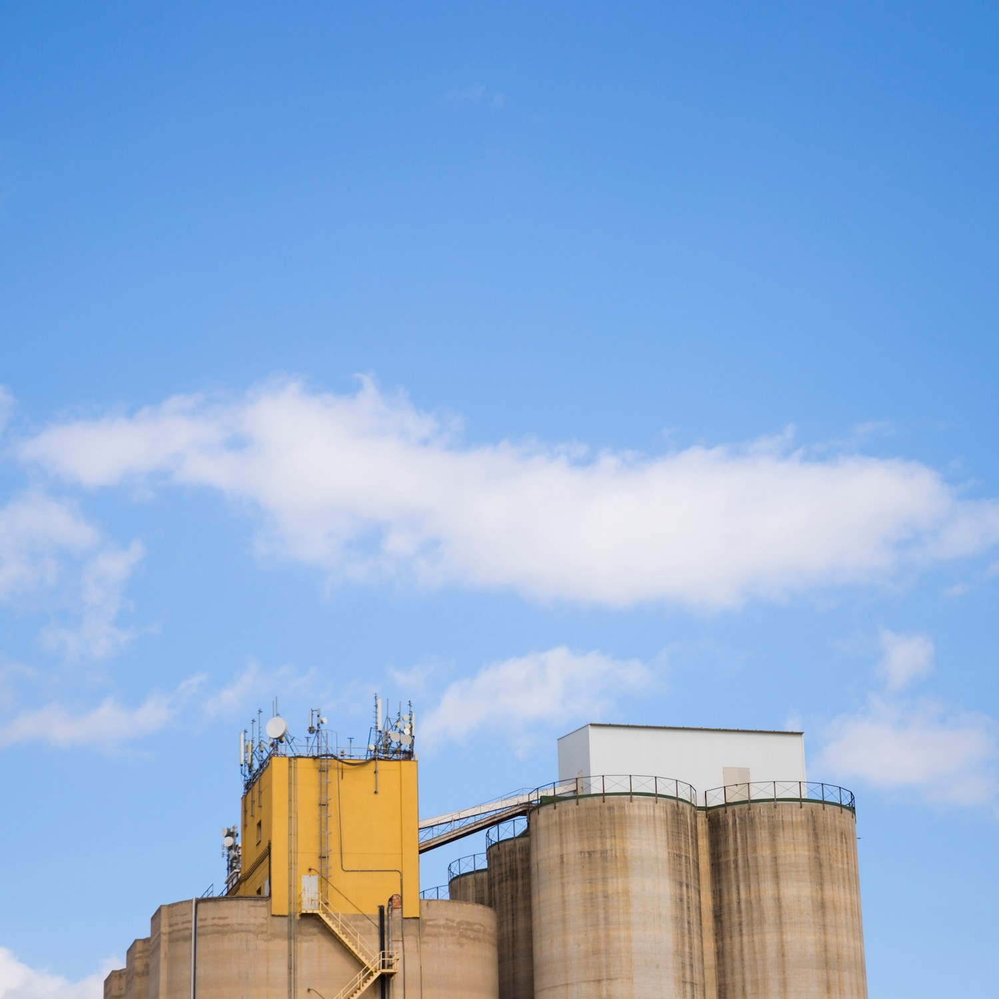
Actual Case Study
Background:
Chennai, the capital city of Tamil Nadu in India, faces challenges related to wastewater management and energy sustainability. With rapid urbanization and population growth, the city generates significant amounts of sewage daily, posing environmental and public health concerns. In response, the Chennai Metropolitan Water Supply and Sewerage Board (CMWSSB) initiated projects to harness biogas from sewage treatment plants (STPs) for power generation.
Challenges:
1. Wastewater management: Chennai generates large volumes of sewage daily, requiring effective treatment to prevent pollution of water bodies and groundwater contamination.
2. Energy demand: Chennai faces a growing demand for electricity, and traditional fossil fuel-based power generation contributes to greenhouse gas emissions and air pollution.
3. Resource optimization: Sewage contains organic matter that can be harnessed for energy generation, but conventional sewage treatment methods often do not utilize this resource efficiently.

Slide 5

Solution:
1. Anaerobic digestion: CMWSSB implemented anaerobic digestion technology in sewage treatment plants to break down organic matter in the sewage and produce biogas, primarily consisting of methane and carbon dioxide.
2. Biogas utilization: The biogas produced is captured and utilized as a renewable energy source to generate electricity and heat, reducing the dependence on fossil fuels.
3. Power generation infrastructure: CMWSSB installed biogas power generation units within sewage treatment plants, integrating them into the existing infrastructure to maximize energy recovery.
Results:
1. Renewable energy generation: The biogas power generation projects have enabled Chennai to produce renewable energy from sewage, reducing reliance on fossil fuels and mitigating greenhouse gas emissions.
2. Energy self-sufficiency: By utilizing biogas for power generation, CMWSSB has reduced electricity costs and increased the resilience of sewage treatment plants to power disruptions.
3. Environmental benefits: Biogas power generation helps to reduce air pollution and mitigate climate change by displacing emissions from fossil fuel-based power generation.

Slide 6

Lessons Learned:
1. Integration of renewable energy generation within sewage treatment infrastructure can enhance resource efficiency and sustainability.
2. Public-private partnerships and stakeholder engagement are crucial for the successful implementation and operation of biogas power generation projects.
3. Continued investment in research and development is essential to optimize biogas production processes and improve the efficiency of biogas power generation systems.
Overall, biogas power generation from sewage treatment plants in Chennai
exemplifies the potential for turning wastewater into a valuable resource for renewable energy production while addressing environmental and energy challenges in urban areas.

Slide 7

Biblography
https://www.ijrpr.com/uploads/V2ISSUE2/IJRPR202.pdf
https://www.wabag.com/wabag-blogs/waste-to-energy-achieving-self-sustenance-in-sewage-treatment-plant/
https://byjus.com/biology/sewage-treatment/
https://chat.openai.com/c/06117860-b040-4768-85ba-ff7fc3b9b6ee

Slide 8
Thank You

